Slide 1

Traffic Accident Analysis Using Python
Exploring patterns, trends, and insights in traffic accident data.

Slide 2

Project Objectives
1
Analyze Accident Data
2
Visualize Insights
Use Python libraries.
Uncover patterns and trends.
3
Dataset
File: traffic_accidents.csv.

Slide 3




Data Preprocessing Steps
Data Loading
Load dataset with pandas.
Missing Values
Handle missing data.
Categorical Conversion
Convert columns for analysis.

Slide 4
Crash Types Distribution
Visualization
Insights
Bar chart of crash types.
Rear-end collisions are common.

Slide 5


Most Severe Injuries
Insights
Visualization
1
2
Fatal injuries are a small percentage.
Pie chart of injury severity.

Slide 6
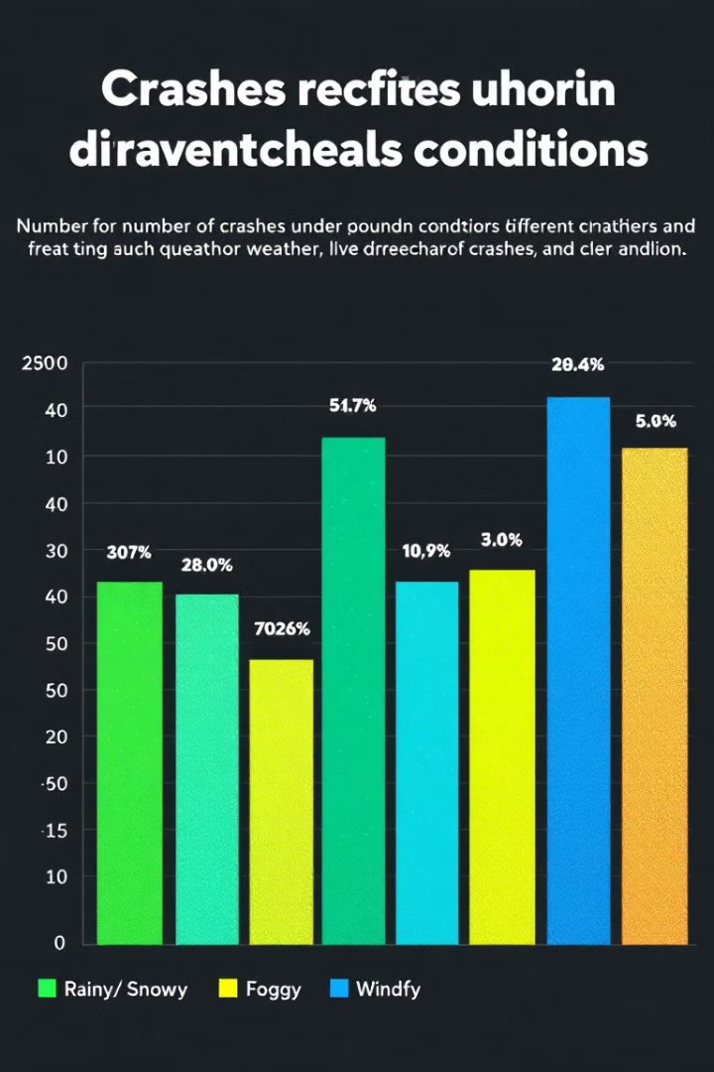
Crashes by Weather
Visualization
Bar chart of weather conditions.
Insights
Clear weather has most crashes.

Slide 7
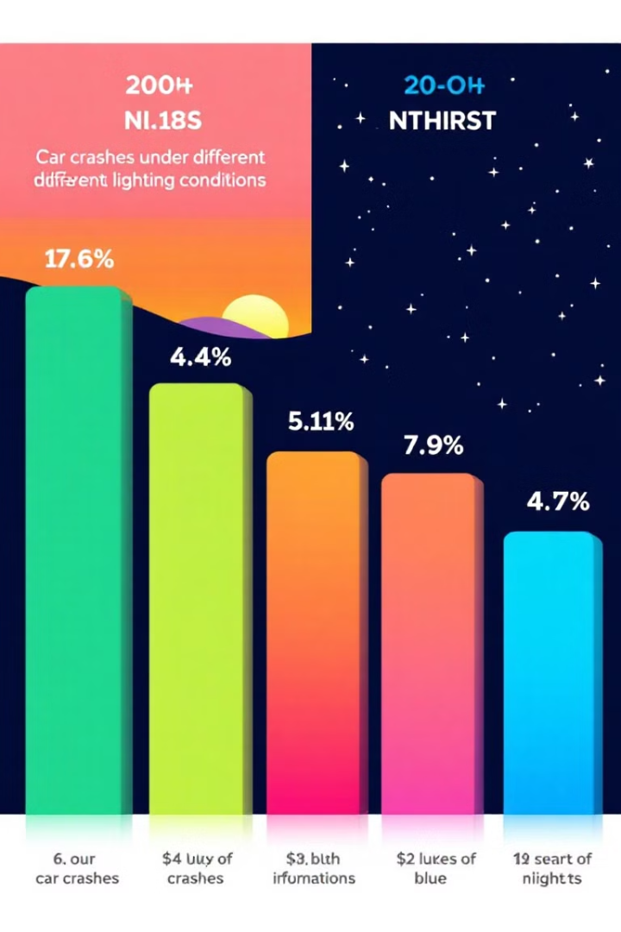


Crashes by Lighting
Daylight
Nighttime
Highest number of crashes.
Fewer crashes.

Slide 8

Key Findings
Crash Types
1
Rear-end collisions are common.
2
Weather
Clear weather has most crashes.
Injuries
3
Fatal injuries are rare.

